Slide 1
Heart Disease Prediction
Name: Aayushi.V.Kosambia
Enrollment No.: 200420107096
Branch: CO (DIV-II)
Email:aayushikosambia.co20d2@scet.ac.in
Subject: Introduction to Data Analytics

Slide 2
AGENDA
2
Introduction​
​Objectives
Features
Method
Algorithms Used
Typical target group who will use solution
Limitations
Different Analytics (Parameters).

Slide 3

Introduction
According to the World Health Organization, every year 12 million deaths occur worldwide due to Heart Disease.
Heart Disease is even highlighted as a silent killer which leads to the death of the person without obvious symptoms.
The early diagnosis of heart disease plays a vital role in making decisions on lifestyle changes in high-risk patients and in turn reduce the complications.
This project aims to predict future Heart Disease by analyzing data of patients which classifies whether they have heart disease or not using Data Analytics

Slide 4
Objectives
4
To develop machine learning model to predict future possibility of heart disease by implementing Logistic Regression.
To determine significant risk factors based on medical dataset which may lead to heart disease.
To analyze feature selection methods and understand their working principle.

Slide 5
Features
Age
Gender
Chest pain type(cp)
Trestbps
Cholesterol(Chol)
Fasting blood sugar(fbs)
Resting electrocardiographic results(restecg)
Thalach
Exercise induced angina(exang)
Oldpeak
Slope
Ca
Thal
Target

Slide 6




Method
Dataset
Data Pre-processing
Feature Selection Based on Information Gain
Imbalance Data Processing Based on Smote-Enn
Baseline Alogorithms

Slide 7
ALGORITHMS USED
Logistic Regression
Backward Elimination Method
Recursive Feature Elimination using Cross-Validation (RFECV)

Slide 8
Typical target group who will use solution
Clinical decisions are often made based on doctor’s insight and experience rather than on the knowledge rich data hidden in the dataset. This practice leads to unwanted biases, errors and excessive medical costs which affects the quality of service provided to patients.
The proposed system will integrate clinical decision support with computer-based patient records (Data Sets).
This will reduce medical errors, enhance patient safety, decrease unwanted practice variation, and improve patient outcome. This suggestion is promising as data modeling and analysis tools, e.g., data mining, have the potential to generate a knowledge rich environment which can help to significantly improve the quality of clinical decisions.
There are voluminous records in medical data domain and because of this, it has become necessary to use data mining techniques to help in decision support and prediction in the field of healthcare. Therefore, medical data mining contributes to business intelligence which is useful for diagnosing of disease

Slide 9



Limitations.
ROI
NICHE MARKETS
SUPPLY CHAINS
Envision multimedia-based expertise and cross-media growth strategies
Visualize quality intellectual capital
Engage worldwide methodologies with web-enabled technologies
Pursue scalable customer service through sustainable strategies
Engage top-line web services with cutting-edge deliverables
Cultivate one-to-one customer service with robust ideas
Maximize timely deliverables for real-time schemas

Slide 10
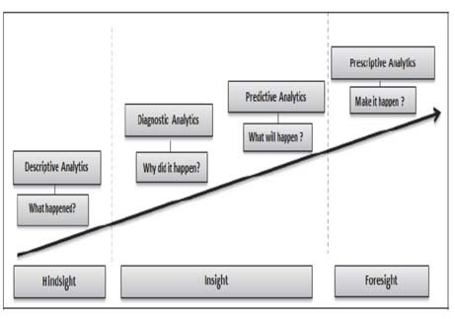
different analytics (parameters).

Slide 11
THANK YOU
Aayushi.V.Kosambia

